Slide 1
Overview
Saw some gait cycle data that appeared to have a lag between trials within a timepoint & speed combination. Determined that in two cases, it is due to GaitRite trials being saved out of order
SS02 SHAM1 POST SSV
SS06 TOL30 POST SSV
Fixed this with an additional step in the processing pipeline to check the times that each trial was saved by each hardware system to ensure alignment

Slide 2
SS02 SHAM1 POST SSV JOINT ANGLE

Slide 3
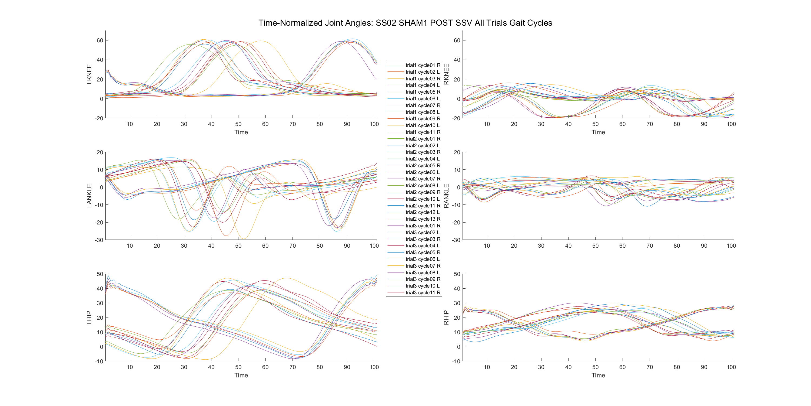
Incorrect trial order

Slide 4
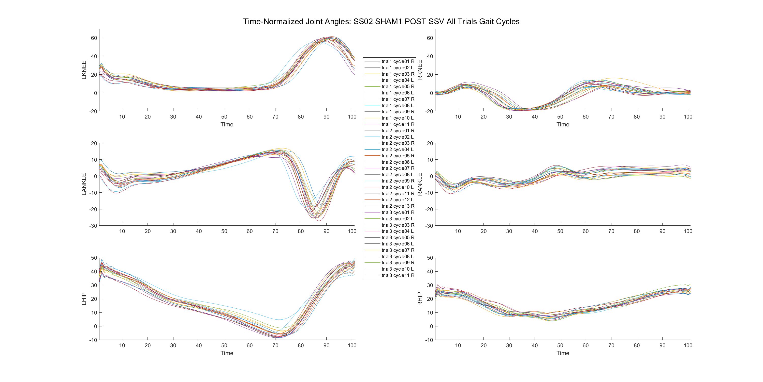
Corrected trial order

Slide 5
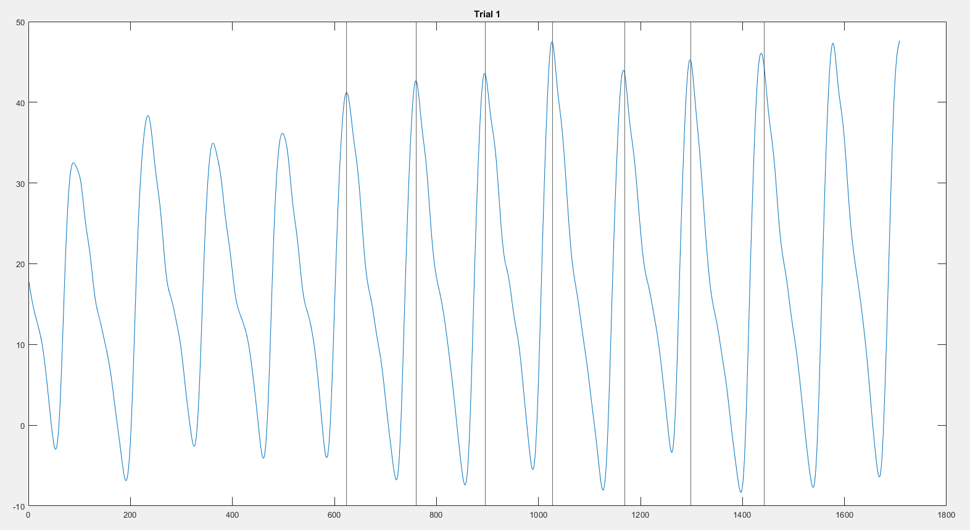
SS02 SHAM1 POST SSV LHIP JOINT ANGLE
Vertical lines are left heel strikes

Slide 6
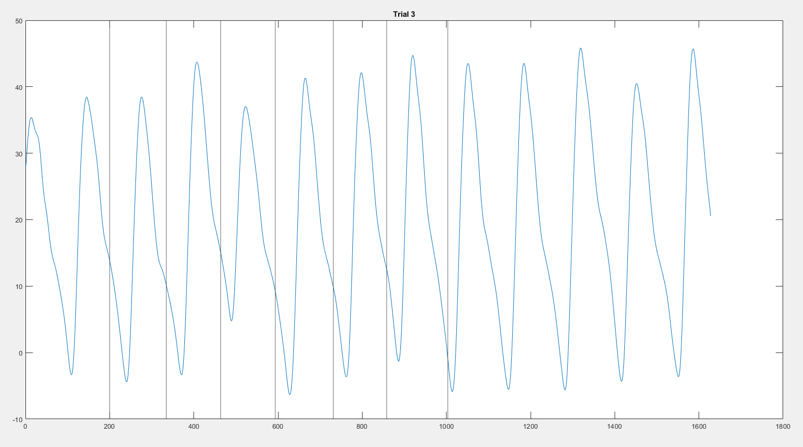
SS02 SHAM1 POST SSV LHIP JOINT ANGLE
Vertical lines are left heel strikes

Slide 7
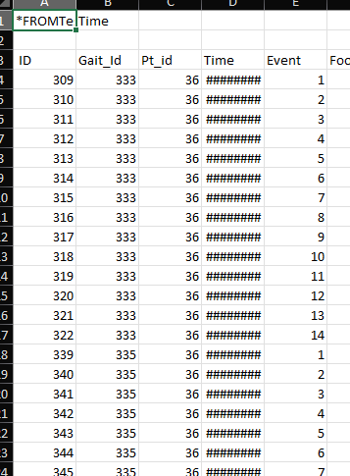
GaitRite skips a number – because redid a trial?
Question: Maybe when redoing a trial the syncing the next time is not good?

Slide 8
SS02 SHAM1 POST SSV EMG

Slide 9
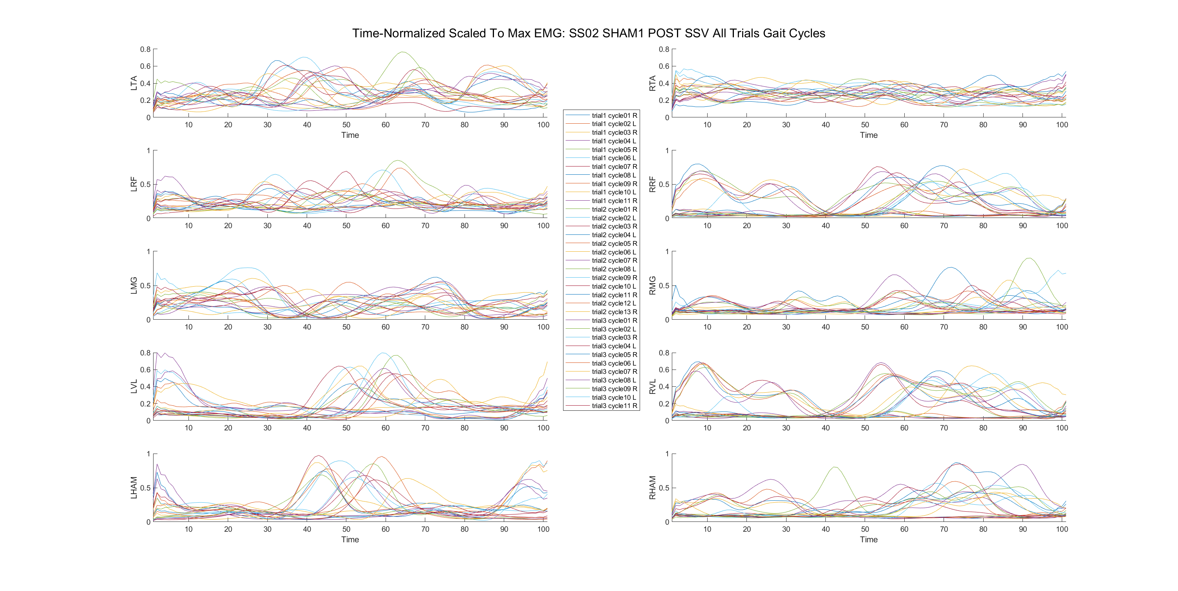
SS02 SHAM1 POST SSV EMG

Slide 10
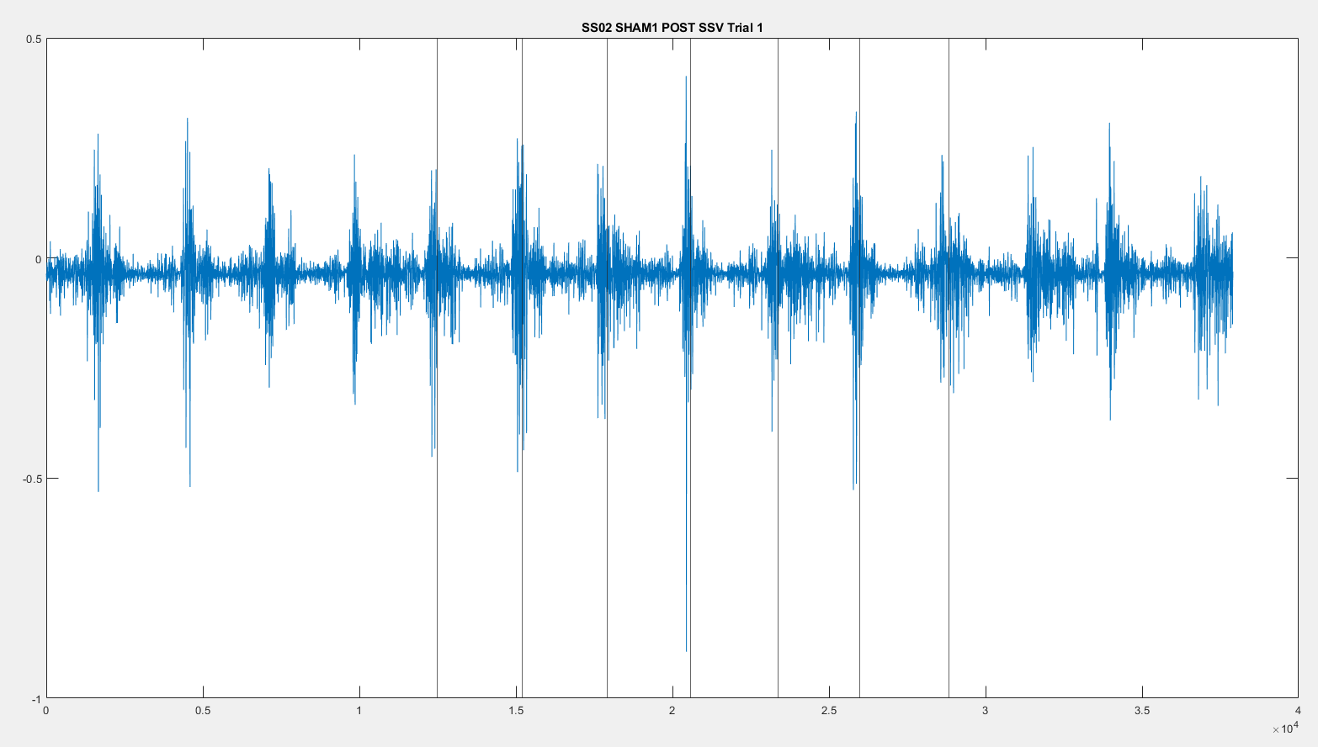
SS02 SHAM1 POST SSV LHAM EMG Trial 1
Vertical lines are left heel strikes
Properly segmented

Slide 11
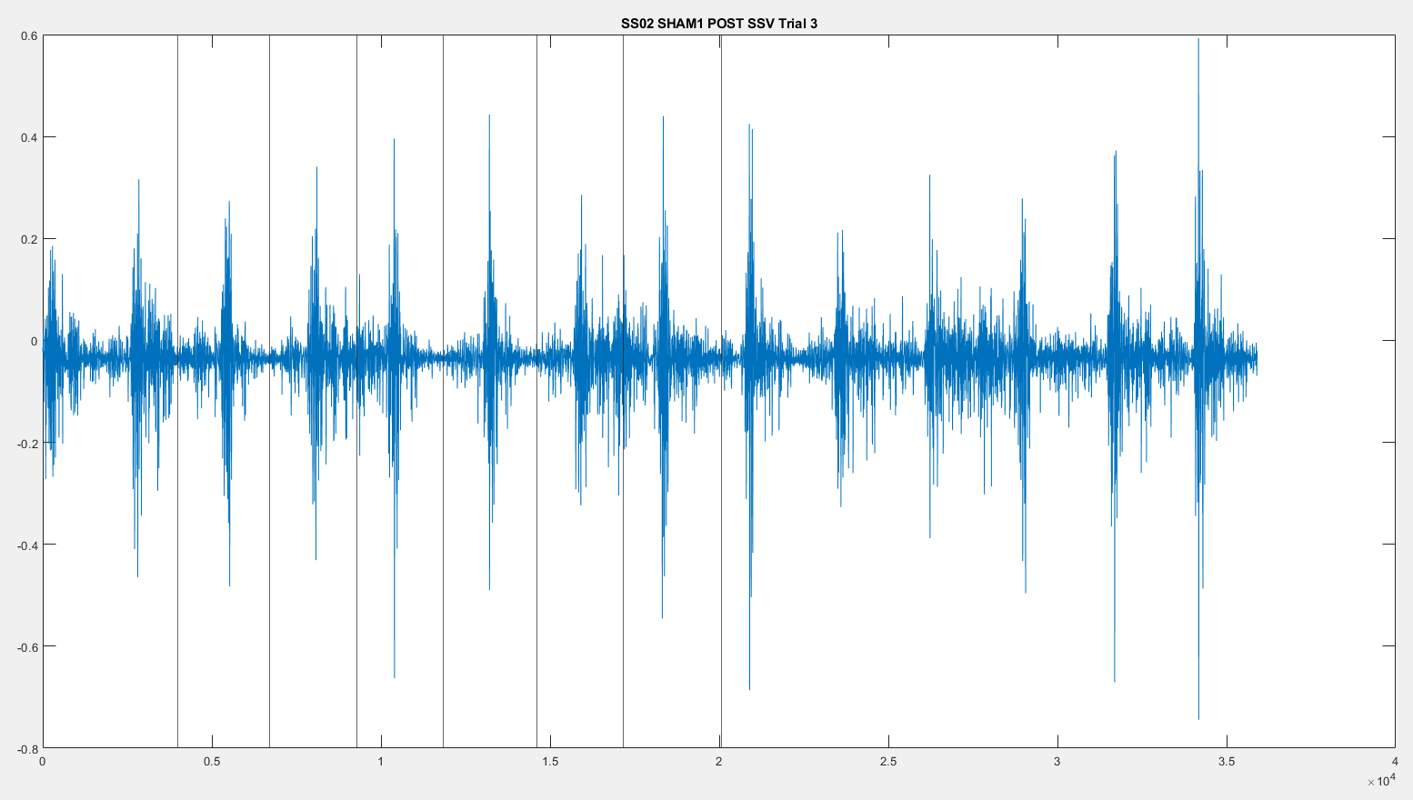
SS02 SHAM1 POST SSV LHAM EMG Trial 3
Vertical lines are left heel strikes
Improperly segmented

Slide 12
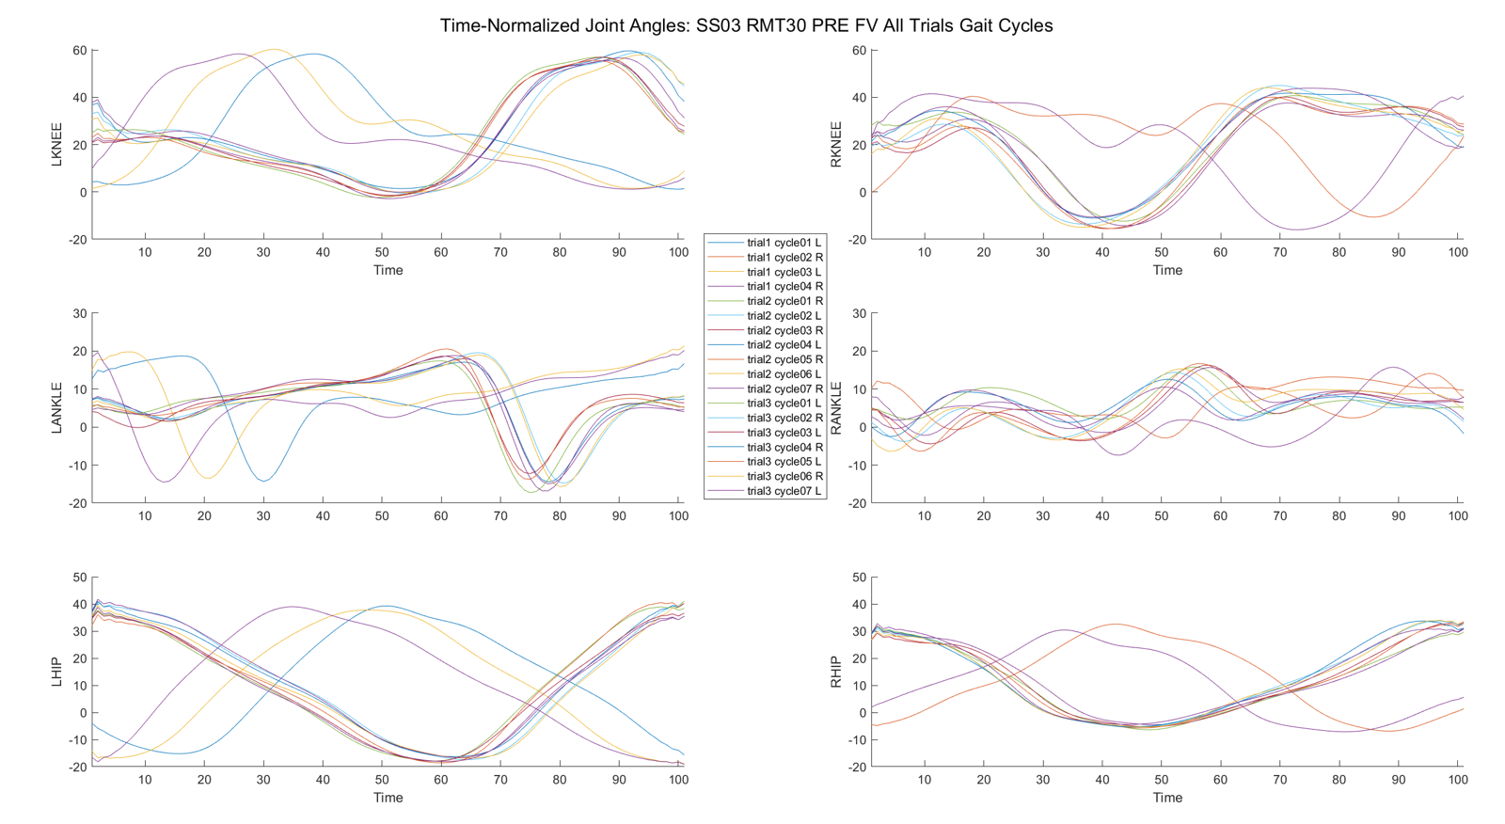
SS03 RMT 30 PRE FV
The theory in the previous slide fails in this trial – no trials were missed here, yet it looks like there’s a lag.

Slide 13
SS06 TOL30 POST SSV

Slide 14
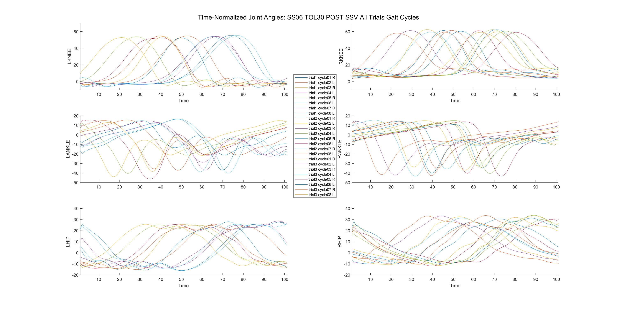
Incorrect trial order

Slide 15
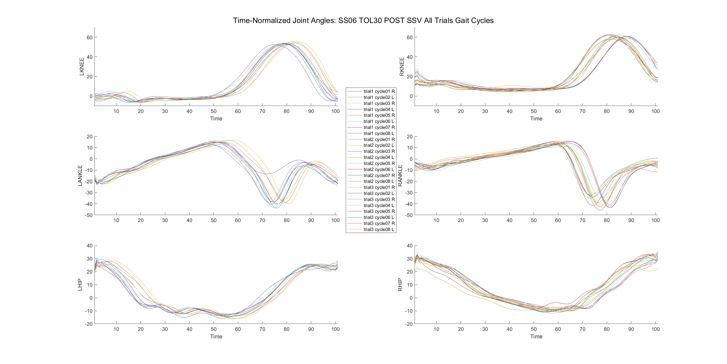
Corrected trial order

